Slide 1
Team No. 17
Adaptive Smart Keyboard with On-Demand AI Interaction and Knowledge-Aware Text Generation
Presentation By,
Mithun Sanjith.V(23BTRCL151)
Aswin Angras.A(23BTRCL032)
Ahamed Dheethath.S(23BTRCL012)
Joel Jefrin.J(23BTRCL144)
Gokul.R(23BTRCL140)
Dharun.P(23BTRCL014)
Guided By,
Dr. RENUKA DEVI.P
Assistant Professor / CSE-AIML

Slide 2
CONTENTS
Abstract
Introduction
System requirement
Literature Survey
Existing system
Block diagram
Proposed System
Conclusion
References

Slide 3
ABSTRACT
Smart keyboards are really important for talking to people because they can guess what you want to type and give you suggestions.The keyboards we have now are not great because they are always using artificial intelligence and do not care about what the user is good at. Also people are worried about their privacy because all the information is stored in one place..
This paper is about a kind of smart keyboard that can work with artificial intelligence when you want it to. It also knows what you know. Can suggest things based on that. The new system lets you decide when you want help from the intelligence so you do not get confused. It also changes what it suggests based on how much you know about something. The smart keyboard keeps your information safe on your device.
The people who made this system tried it out. It works better, than the old systems. It is more helpful. It keeps your information private.
To further enhance privacy, Differential Privacy (DP) is integrated into the training process through gradient clipping and noise addition, providing formal mathematical privacy guarantees measured by a privacy budget (ε)..

Slide 4
INTRODUCTION
Digital communication is a part of our daily lives now. We use smartphones and social media all the time. Smart keyboards help us communicate better by giving us features like text and suggestions. These features help us type faster and make mistakes. Even with these features smart keyboards still have some problems. They can be hard to use. Do not always understand what we want.
Smart keyboards use a system where they send our typing information to a big computer somewhere else. This can be a problem because we often type information like passwords. We do not want this information to be seen by others. Also these keyboards always try to help us by giving us suggestions. Sometimes we do not need help and these suggestions can be annoying. They can also give us much information and make it hard for us to think. Another problem is that these keyboards do not understand if we are beginners or experts. They treat us all the same.To fix these problems we made a kind of smart keyboard..
Each device trains a local model using its own data and sends only model updates (such as weights or gradients) to the server. The server then aggregates these updates using algorithms like Federated Averaging (FedAvg) to improve the global model.

Slide 5
SYSTEM REQUIREMENT
Programming Language: Python 3.8+
Deep Learning Framework: PyTorch
Federated Learning Framework: Flower
Privacy Technique: Differential Privacy ( Opacus)
Libraries: NumPy, Pandas, Matplotlib, Scikit-learn
Server Environment: Central Aggregation Server (FedAvg Algorithm)
Client Environment: Android Device / Simulated Clients
Input Data: Text Dataset (Tokenized & Preprocessed)
Optimizer: Adam

Slide 6
LITERATURE SURVEY
Federated Learning for Decentralized Training :
Federated Learning (FL) enables multiple clients to collaboratively train a shared model without transferring raw data. The Federated Averaging (FedAvg) algorithm reduces communication cost while maintaining performance.
LSTM for Next-Word Prediction :
Long Short-Term Memory (LSTM) networks are widely used for language modeling due to their ability to capture sequential dependencies and contextual relationships in text data.
Privacy Risks in FL :
Studies indicate that model updates in federated learning may still leak sensitive information, highlighting the need for stronger privacy mechanisms.
Differential Privacy in Deep Learning :
Differential Privacy (DP) protects individual data contributions using gradient clipping and noise addition, providing measurable privacy guarantees.It ensures that the inclusion or exclusion of a single user’s data has minimal impact on the final model, thereby preventing information leakage.

Slide 7
EXISTING SYSTEM
Centralized Model
Existing smart keyboards mainly rely on predictive text, autocorrection, and basic context‑aware suggestions to improve typing speed. These systems use machine learning models to predict the next word based on user typing patterns. However, suggestions are generated continuously without user control, which often leads to distractions and irrelevant recommendations.
Another limitation is the lack of personalization. Most keyboards treat all users the same and do not adapt based on user expertise or communication style. Additionally, many existing systems rely on cloud-based processing, raising privacy concerns and increasing dependency on internet connectivity. These limitations highlight the need for a more adaptive and user‑controlled smart keyboard system.
Furthermore, many existing keyboard systems rely on centralized cloud-based processing for training and generating suggestions. This introduces significant privacy concerns, as user typing data may contain sensitive personal or professional information. Continuous background processing and cloud communication also increase latency and dependency on internet connectivity.

Slide 8
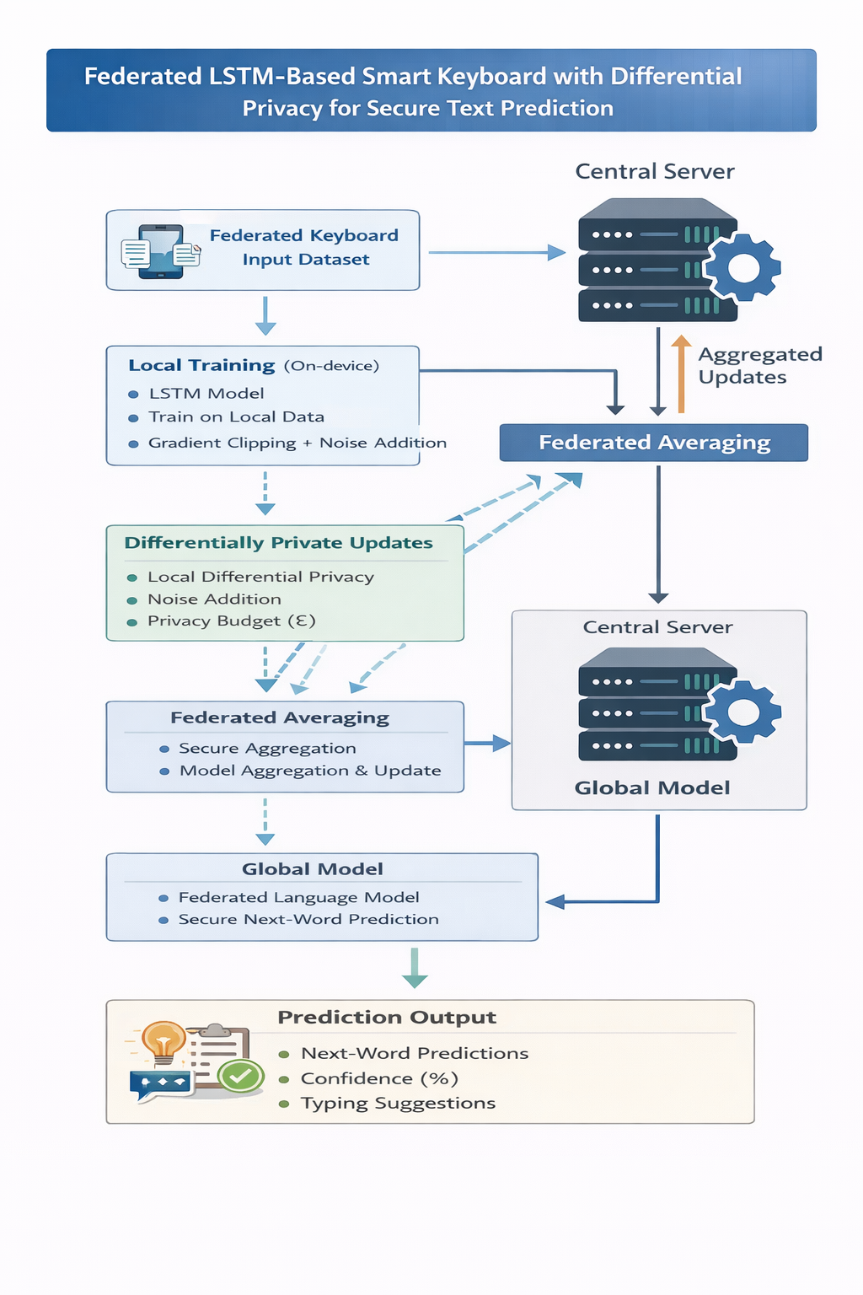
BLOCK DIAGRAM

Slide 9
PROPOSED SYSTEM
On‑Demand AI Toggle Interaction
The proposed system introduces an Adaptive AI‑Enabled Smart Keyboard designed to improve communication efficiency, personalization, and user control. The system integrates advanced AI capabilities directly into the keyboard while ensuring privacy and usability.
The proposed keyboard includes a dedicated AI toggle button that allows users to activate artificial intelligence only when required. Once enabled, the keyboard transforms into an AI chat interface, generates the required message based on user prompts, and automatically returns to normal typing mode after generation.
The system adapts to different user expertise levels by analyzing communication patterns. Beginner users receive detailed suggestions, while expert users receive concise and professional responses, improving communication efficiency.
To provide stronger privacy protection, Differential Privacy (DP) techniques such as gradient clipping and noise addition are applied during local training, ensuring that individual user data cannot be inferred from model updates.
The AI agent understands user intent and generates structured, meaningful responses. Users can review, edit, or regenerate responses before sending, providing full control over communication.

Slide 10
CONCLUSION
This research paper is about an Adaptive AI Enabled Smart Keyboard. This keyboard is designed to make digital communication better with the help of assistance and knowledge aware text generation. The system has a way of interacting with the user using an AI toggle. This means that users can turn on the intelligence only when they need it. This is different from smart keyboards that are always giving suggestions. The Adaptive AI Enabled Smart Keyboard gives users control reduces the amount of information they have to deal with and makes communication more efficient. The system also takes into account the users level of expertise and the context in which they are communicating. This makes the text generation more meaningful and relevant.
The system can also be made to work and be more private by using lighter AI models and processing data on the device. Overall the Adaptive AI Enabled Smart Keyboard is a step towards making digital communication more intelligent and user friendly. It offers usability, personalization and privacy. The Adaptive AI Enabled Smart Keyboard is a tool, for modern digital interactions.

Slide 11
REFERENCES
https://doi.org/10.3390/su17198761
http://creativecommons.org/licenses/by-nc/4.0/)
Intelligent Waste Classification System Using Deep Learning Convolutional Neural Network . (SMPM) 2019 , 10.1016/j.promfg.2019.05.086.
Classification of Waste Materials using CNN Based on Transfer Learning . fire ’22: forum for information retrieval evaluation ; https://dl.acm.org.com
Garbage In, Insights Out: Deep Transfer Learning for Automatic Solid Waste Classification “.2024 IEEE 1st International Conference on Green Industrial Electronics and Sustainable Technologies (GIEST).

Slide 12
THANK YOU

